Slide 1
The impact of Covid-19 pandemic on Iranian National Tax Administration 2020-2022
Iranian National Tax Administration
INTA

Slide 2
Table of content
Introduction
Trend of covid-19 infection and mortalities
A brief look at I.R.I tax system
Effects of Covid-19 on I.R. tax system
Types of measures taken by INTA during the pandemic
Types and objective of policy measures taken by INTA
Policy measures taken by INTA during Covid-19 spread
Administrative measures during the Covid-19 pandemic

Slide 3
Introduction
Covid-19 & Economy
Causing heavy losses to the public health of the world
Quarantines, travel bans, social distancing and other restrictions caused by Covid-19 have taken a heavy toll on the economy
Covid-19 in Iran
Infected number: 7,528,961
Dead number:143,867
Covid-19
The World Health Organization announced Covid-19 as a pandemic on March 11, 2020.
Covid-19 entered Iran in the First months of 2020

Slide 4
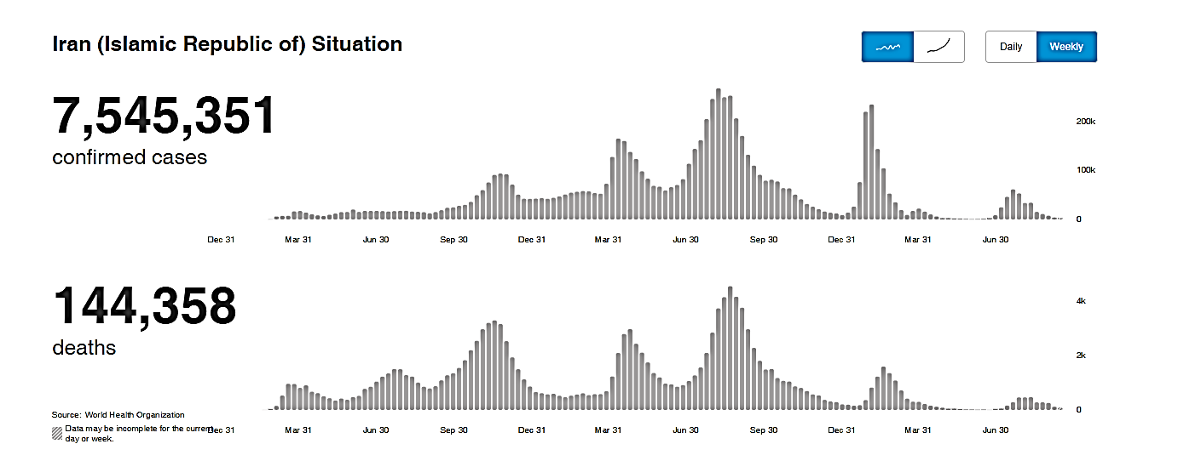
The trend of COVID-19 infections and mortalities in I.R of IRAN

Slide 5
A brief Look at I.R.I Tax system: Tax Mix in 2021-2022 (%)

Slide 6
The structure of Iranian National Tax Administration

Slide 7
employees composition in INTA

Slide 8
Channels of Covid-19 effects on I.R.I Tax System
Direct effects of Covid-19 on INTA
Effects on Tax Collections
Effects on costs of INTA
Indirect Effects of Covid-19 on INTA
Tax Policy Measures
Administrative Measures

Slide 9
Effects on tax collections

Slide 10
Major Indicators of Iranian Tax System ( in percent)

Slide 11
Effects on costs/death in INTA
The Number of infected employees:1715
The Number of death:28
first dose injection:1047
Reminder dose injection:67
Loan to infected employees:1114 cases

Slide 12
Measures and costs incurred by INTA to combat Covid-19
Sterilizing and disinfecting tax offices throughout the country and distributing masks and glove and Disinfectants gel among employees
measurement of employees and clients’ body temperature.
Reducing employees working hours by implementing remote working system.
Facilitating the use of sick leave for employees with symptoms of illness
Implementing systems to get public reports about tax evasion through INTA,s portal
Prohibition of extra-provincial and city administrative missions, and
Vaccination of all employees of tax offices

Slide 13
Types and objective of policy measures taken by INTA
Three kind of policy measures:
Facilitating urgent measures to ease the burdens on taxpayers and facilitate tax compliance, with difficulties in meeting their tax reporting or payment obligations.
Supportive measures to ease businesses and individuals with cash flow problems.
Med-term suportive measures to reduce tax burden of affected taxpayers

Slide 14
Tax Policy measures taken by INTA during Covid-19
Extension of legal deadlines and statute of limitations
Suspension of field Audits
Suspenssion of tax enforcements
Exemption of need for Tax Certification issuance
Suspension of tax dispute settlement meetings
Remittance of tax Fines
Granting Tax allowance
Reduction of income tax rate for affected unicorpotate inividual businesses
Reduction of CIT rate for affected taxpayers
Granting tax credit for affected indivdual businesses

Slide 15
Extension of legal deadlines and statute of limitations
Extension of deadlines for payment of deferred and overdue tax installments.
Extension of deadlines for the fines remittence.
Extension of deadline for tax audit.
Extension of debt payment moratorium for a maximum of 3 months and installments for 9 months from the date of the initial request regardless of the three-year period;
Extension of overdue VAT payment for affected groups.

Slide 16
Entering into force & Suspension of some operations
Suspension of tax enforcement for affected groups;
Temporary suspension of field audits.
Temporary suspension of dispute resolutions meetings.
Cacealation of tax certification indicating the payment or arrangements for payment, needed for issuance or renewal of business or work license of individuals

Slide 17
Forgiveness of tax fines
Complete forgiveness of the fines for non-filling and for delayed payment penalties for taxpayers under certain conditions
100 % forgiveness of the fines for VAT non-filling for unincorporated individual businesses affected by the Covid-19
forgiveness of VAT and duties delayed payment penalties providing that the principal VAT and duty amounts are paied in full

Slide 18
Granting Tax Allowance
Individuals and legal entities’ cash and non-cash donations (February to May of 2019) which have been spent to meet hospitals and public medical centers required tools and equipments, approved by the ministry of health and medical education .

Slide 19
Amendment of tax laws and regulations
Replacing tax credit with tax exemptions
5% tax credit to production and businesses affected by Corona (individual businesses)
Zero tax rate to support public-private partnerships.
5% CIT rate reduction for affected legal entities
Imposing tax on luxury assets
Increasing effective tax rate of tobacco consumption
Exemption of textbook publications and artistic activities.

Slide 20
Administrative measures during the Covid-19 pandemic
Improving taxpayer compliance and combating tax evasion.
Improving taxpayer services .
Improving taxpayers contact points
Implementation whistle blowing system
Implementation of new VAT law
Implementation of law on POS and taxpayers’ system(online cash register)
Establishment an electronic complaint registration system to the Supreme Tax Council
Launching electronically notification of tax documents
Implementation of electronic property transfer tax system
Implementing online payment system of departure fees
Developing digital and data-driven tax administration Roadmap.

Slide 21
Administrative measures during the Covid-19 pandemic
Removing redundant business licenses(14 of 29)
implementation of Risk Based Audit(Article 97 of Direct Tax Law)
Reforming and simplifying taxpayer registration process.
Reforming assets depreciation’s rules and regulations
Reforming and easing export’s VAT refund process

Slide 22
Moving towards e-learning due to Corona

Slide 23
The number of training courses held during the corona pandemic

Slide 24
Educational content produced (number)

Slide 25
Training courses held during the Corona pandemic(Person-hour)

Slide 26
Thank you for your time and Patiance

