Slide 1
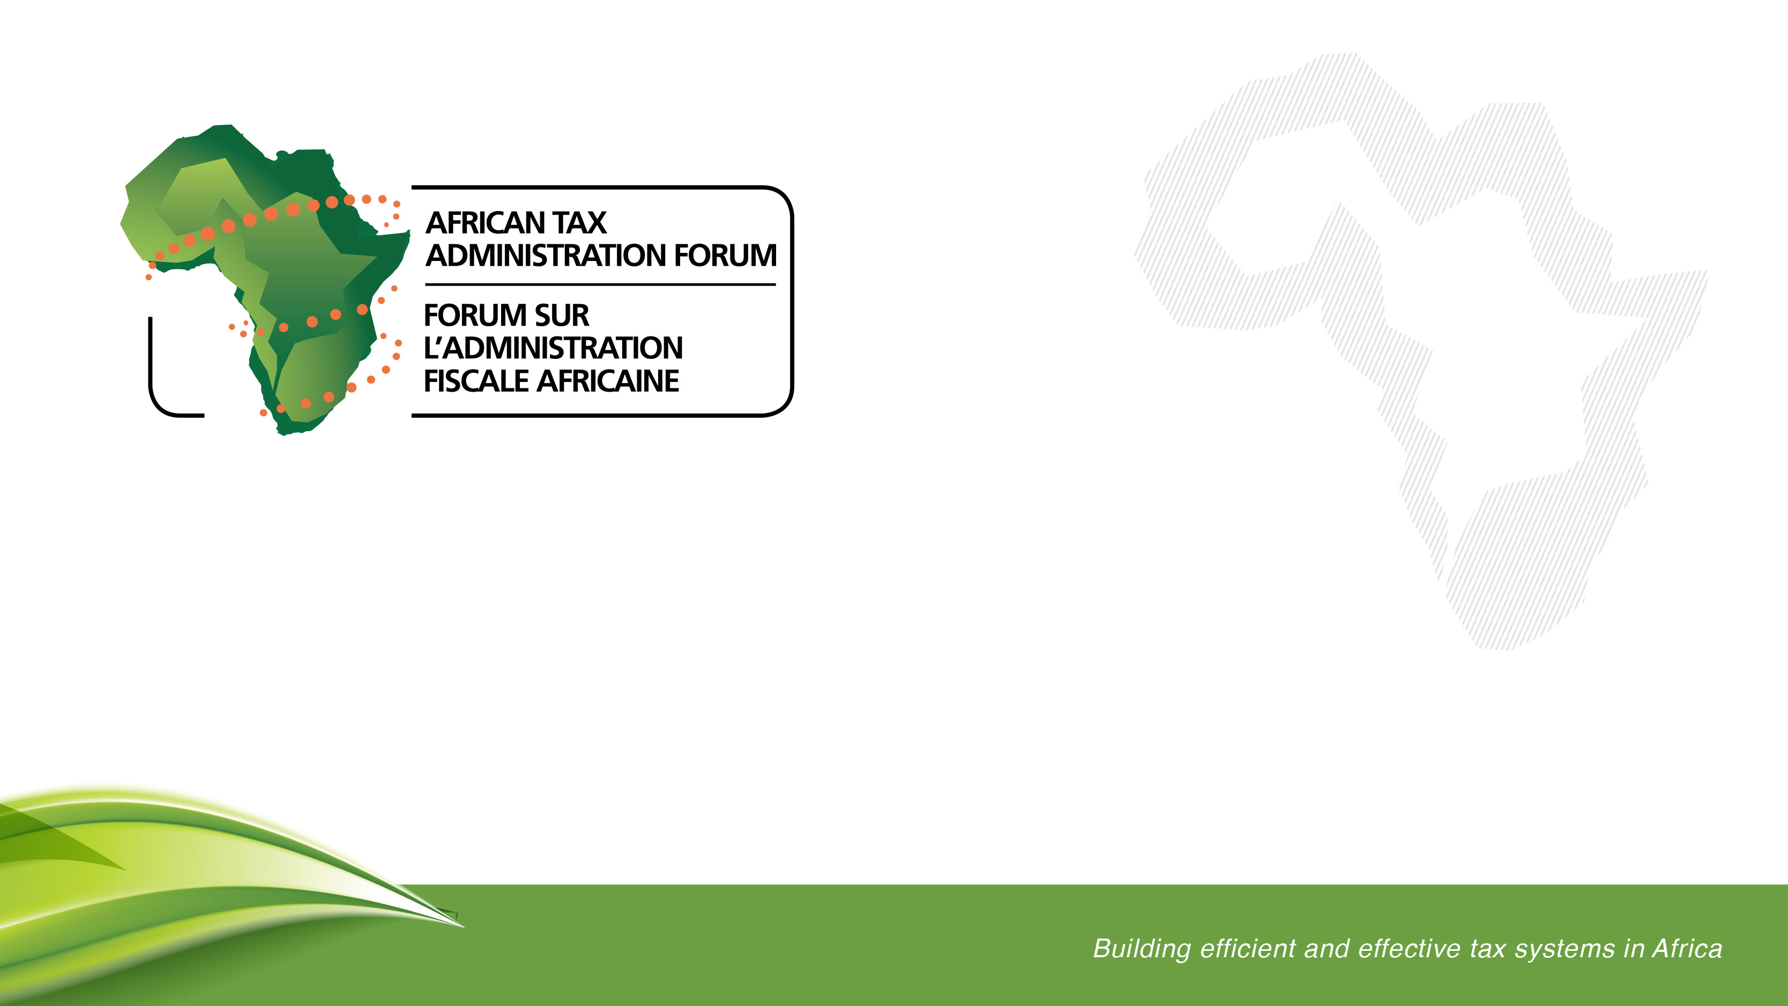
How Can Tax Administration be an Enabler for Investment?
The Role of Digital Transformation in Building Efficiency, Simplicity and Certainty
November 2025

Slide 2
Introduction
Today tax administrations have taken on the transition from enforcers to customer service-driven organizations.
Shifting from “command and control” to “responsive, service-oriented, designed to build trust, support and gain respect in the community”.
Modernization is at the center of this transformation to a service-oriented approach.
Additionally, our taxpayers are changing – they are going digital in payments, reporting, data storage, etc. and they expect us to change too.

Slide 3
What does the research show?
Findings from a study on the impact of tax administration quality on foreign investment in developing countries revealed (TIWB):
Improvements in tax administration quality, on average, attract FDI
Tax administration quality attracts FDI by:
Curbing corruption by tax authorities
Reducing tax uncertainty
Mitigating information and agency problems
Duke Ferguson et al., Tax Administration quality and foreign investment in developing countries (2025)

Slide 4
What does the research show?
Improving tax administration can unlock employment opportunities through four key channels:
Increase investment in growth
Reduce compliance costs for businesses
Promote formalization and
Enhance investor confidence
Better tax regulation, administration and implementation is associated with higher GDP per capita, labor productivity and lower levels of informality.
Jorge Clemente de Leon Miranda & Viet Anh Nguyen, Effective tax administration is critical in enhancing growth and creating jobs (2025)

Slide 5

What does the research show?
Digital transformation, transparent enforcement, and streamlined tax procedures are key to maximizing the benefits.
Tax administrations need to adapt to changing business models and technological advancements – prioritize efficiency, equity and growth
Jorge Clemente de Leon Miranda & Viet Anh Nguyen, Effective tax administration is critical in enhancing growth and creating jobs (2025)

Slide 6

A Whole of Government Approach to Digital Reform
Digital transformation is now a cornerstone of public sector transformation – enabling digital public service.
But it cannot function in isolation – there is a need for a connected government, a highway of services that enables interconnected service delivery
An integrated approach to digital transformation is key – cohesion is key to delivering simplicity and certainty as a package to all investors.

Slide 7
Simplicity
In the world of digital tools the user experience is key: simplicity is a fundamental consideration for the taxpayer experience.
The taxpayer interface should be easy to use
Provides information
Accessible for all
Facilitates voluntary compliance
Reduces compliance burden

Slide 8
Regard for Taxpayers’ Rights in the Digital Realm
The more technology we use, the more we must be concerned with how it is used and how its use impacts taxpayers:
Artificial Intelligence has brought on new risks requiring the right to human intervention
Data protection, privacy and security are now more important than ever.
Cyber security
Transparency

