Slide 1
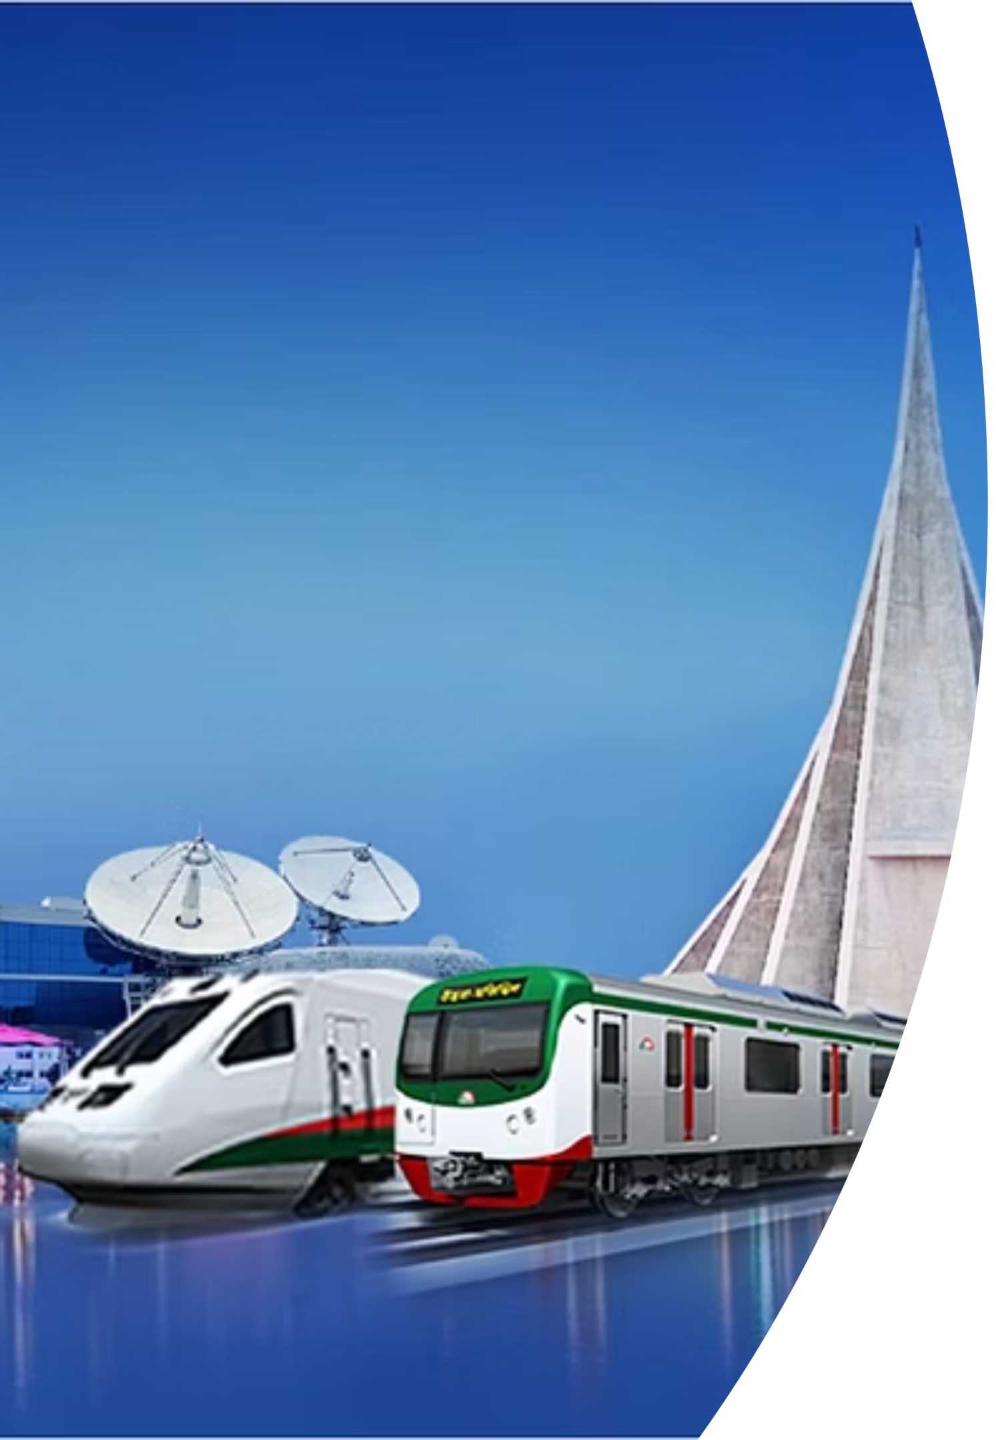
Tax Policies in Bangladesh:
Stimulating Investment Growth & Competitiveness
Towards a sustainable future

Slide 2
Growth story of Bangladesh
Parameters
What We Were
As of Now
Per capita (USD)
129.71 (1971)
2,824 (2022-23)
Literacy Rate
29.23% (1981)
77% (estimated 2023)
GDP growth
4.62% (1976)
6.03 (2023)
GDP (USD)
8 bn (1973)
465 bn (2022)
Export (USD)
0.4bn (1976)
56 bn (2022-23)
FDI (USD)
7 million (1977)
3250 million (FY 2023)
Electricity Gen. Capacity
3362 MW (2009)
30,067 MW (2025)

Slide 3













Emblem of Inclusive Progress
2nd Largest Vegetable Producer
World's Dress Maker
Self Sufficient in Food
3rd largest Fish Producer
7
100% Electricity Coverage
2nd Highest IT Freelancers
Smart Disaster Management

Slide 4
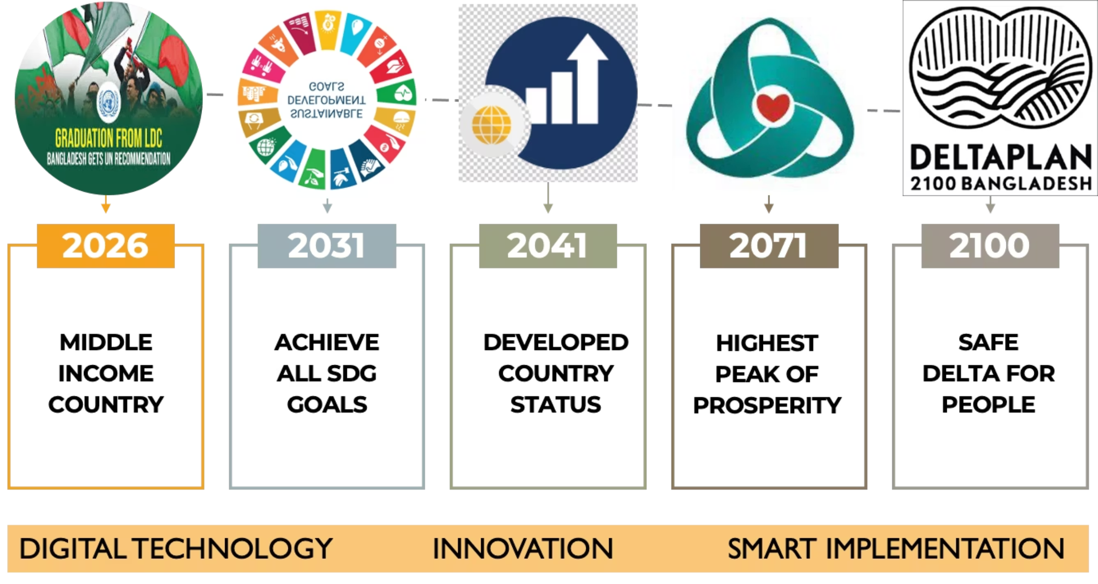
Towards Vision 2100
28th largest economy of World by 2030*
* PWC projection

Slide 5
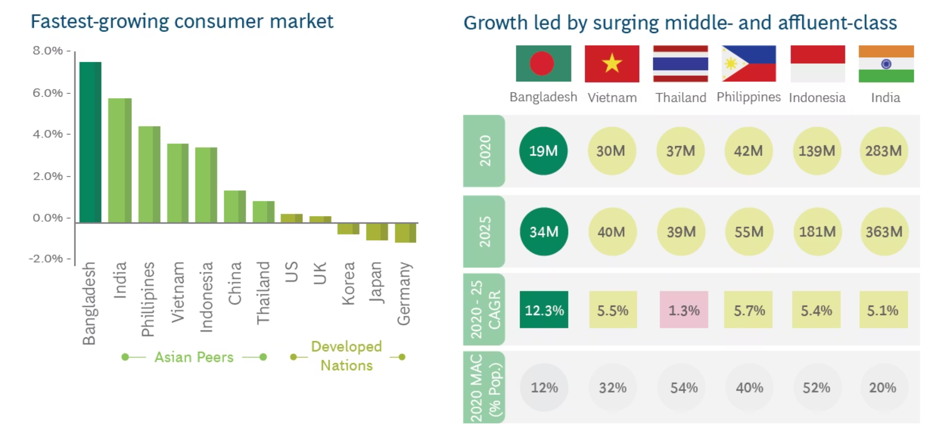
Bangladesh: 9th Largest Consumer Market Globally by 2030 with 34 million people in Middle Income and Affluent Class by 2025
Source: HSBC Global Research, BCG's Center of Consumer Insights, BCG analysis, Neilson HH data

Slide 6




Foreign Investment as a Catalyst for Growth
Key Areas of Impact:
Infrastructural Development
Technology and Innovation
Job Creation and Development
Sectoral Diversification
FDI fuels critical infrastructure projects, including roads, ports, energy, and industrial parks, essential for economic growth.
Foreign investment drives advancements in technology and digital sectors.
FDI significantly boosts job creation, especially in manufacturing, and supports skill development across various industries.
Foreign investments enable diversification into high-value sectors: pharmaceuticals, shipbuilding, and renewable energy.

Slide 7
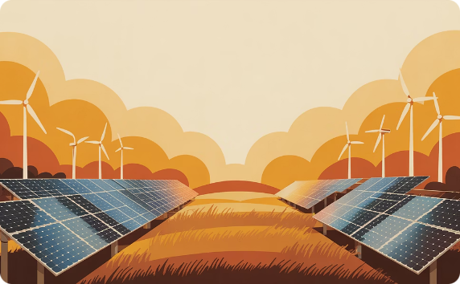
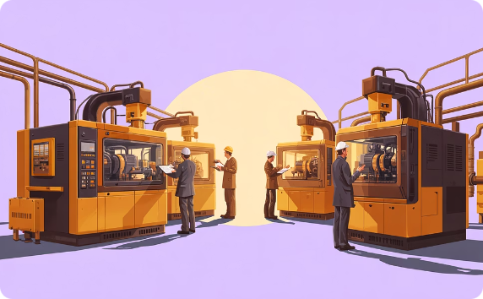


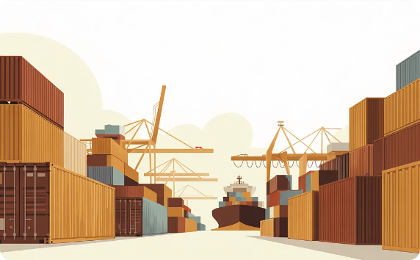
Foreign Investment: Key to Vision 2100
Green Growth
Technology Transfer
Job Creation
Infrastructure Development
FDI fuels renewable energy projects, vital for achieving sustainable development goals.
Foreign investors introduce cutting-edge technologies, enhancing productivity and addressing environmental challenges.
Inflows generate employment opportunities, contributing to a skilled and diverse workforce.
FDI supports the construction of vital infrastructure, boosting connectivity and economic activity.
Export Diversification
Increased participation in global value chains connects the economy with international markets, boosting exports.

Slide 8
Investment Climate: Conducive Policies - for Private Sector Led Growth
Legal Protection
Equal Treatment
Secured by law against nationalization and expropriation
Local and Foreign investments are given equal treatment
Foreign Ownership
Open Sectors
100% foreign equity is allowed along with unrestricted exit
Almost all industrial sectors are open for foreign investors
Bilateral Treaties
Tax Treaties
Bilateral Investment treaties (BITs) signed with 34 countries
Double taxation treaties with 39 countries
International Agreements
Legal Framework
Bangladesh is a signatory to ICSID, UNCITRAL, OPIC, MIGA, WAIPA, WIPO and WTO
All laws, regulations are conducive to investment

Slide 9
Incentives for Investing in Bangladesh
FISCAL INCENTIVES
NON-FISCAL INCENTIVES
Reduced corporate tax in thrust sectors and also in the export-oriented industries
Repatriation of dividend without any govt intervention
Cash incentives on sale is extended to some industries based on the export
Tax holiday for specific industries in the selected locations
Reduced or no customs duty on Import of Capital Machineries
Reduced duty for import of raw materials for industrial use
Tax credit in the income at the home country based on Double Taxation Avoidance Treaty
Reduced tax on the linkage industries of the textile sectors
Low Capital Gain Tax encourages investment in stock market and financial assets
Double Taxation Avoidance Treaty to ensure impartial tax treatment for Investing countries

Slide 10
Core Tax incentives
A. Tax benefit for income from export
50% of income derived by any taxpayer being a company incorporated in Bangladesh from export shall be exempt from tax.
B. Partial tax exemption for newly established undertaking
Qualifying industrial undertaking set up between 1 July 2019 and 30 June 2024 and going into commercial production/operation within those dates will be entitled to apply for the following tax exemption:
Area
Year
Exemption % of income
Dhaka, Mymensingh and Chittagong Divisions excluding Dhaka, Narayanganj, Gazipur, Chittagong, Rangamati, Bandarban and Khagrachari Districts
1st year
90%
2nd year
80%
3rd year
60%
4th year
40%
5th year
20%

Slide 11
Entitled industries for such tax benefits are –
Pharmaceuticals industry
Agriculture machinery
Automobile manufacturing
Electronics manufacturing
Biotechnology and basic agro products
Furniture manufacturing
Home appliances
Leather and leather goods
Petrochemicals
Plastic recycling
Textile machinery
Toy manufacturing
Tyre manufacturing

Slide 12
C. Partial tax exemption for newly established physical Infrastructure facility:
Qualifying physical Infrastructure set up between 1 July 2019 and 30 June 2024 and going into commercial production/operation within those dates will be entitled for the following tax exemption..
Year
Exemption % of income
1st and 2nd
90%
3rd year
80%
4th year
70%
5th year
60%
6th year
50%
7th year
40%
8th year
30%
9th year
20%
10th year
10%
Qualified physical infrastructure for such tax benefits are –
Deep sea port; Elevated expressway; Export processing zone; Flyover; Gas pipe line; Hi-tech park; ICT or software village; IT park; Large water treatment plant supply through pipeline; LNG terminal & transmission line; Mobile phone tower or tower sharing infrastructure; Mono-rail; Rapid transit; Renewable energy; Sea or river port; Toll road or bridge; Underground rail; waste treatment plant.

Slide 13
D. Tax benefits for investment in Special Economic Zones(SEZ)
The business income of industries set up in SEZ is exempted from Income tax fort 10 years from the date of commercial operation in the following manner:
Year
Exemption % of income
1st, 2nd and 3rd
100%
4th year
80%
5th year
70%
6th year
60%
7th year
50%
8th year
40%
9th year
30%
10th year
20%
Furthermore, "capital gains" arising from transfer of share capital, royalty, technical know-how and technical assistance fee paid by such company and declared dividend are exempted from income tax for next 10 years from the date of commercial operation.

Slide 14
E. Tax benefits for Developing unit in SEZ
The business income of SEZ developer is exempted from Income tax for next 12 years from the date of commercial operation in the following manner:
Year
Exemption % of income
1st, to 10th year
100%
11th year
70%
12th year
30%
The foreign technicians appointed in investing unit will get 50% tax exemption for next 3 years from the date of appointment.

Slide 15
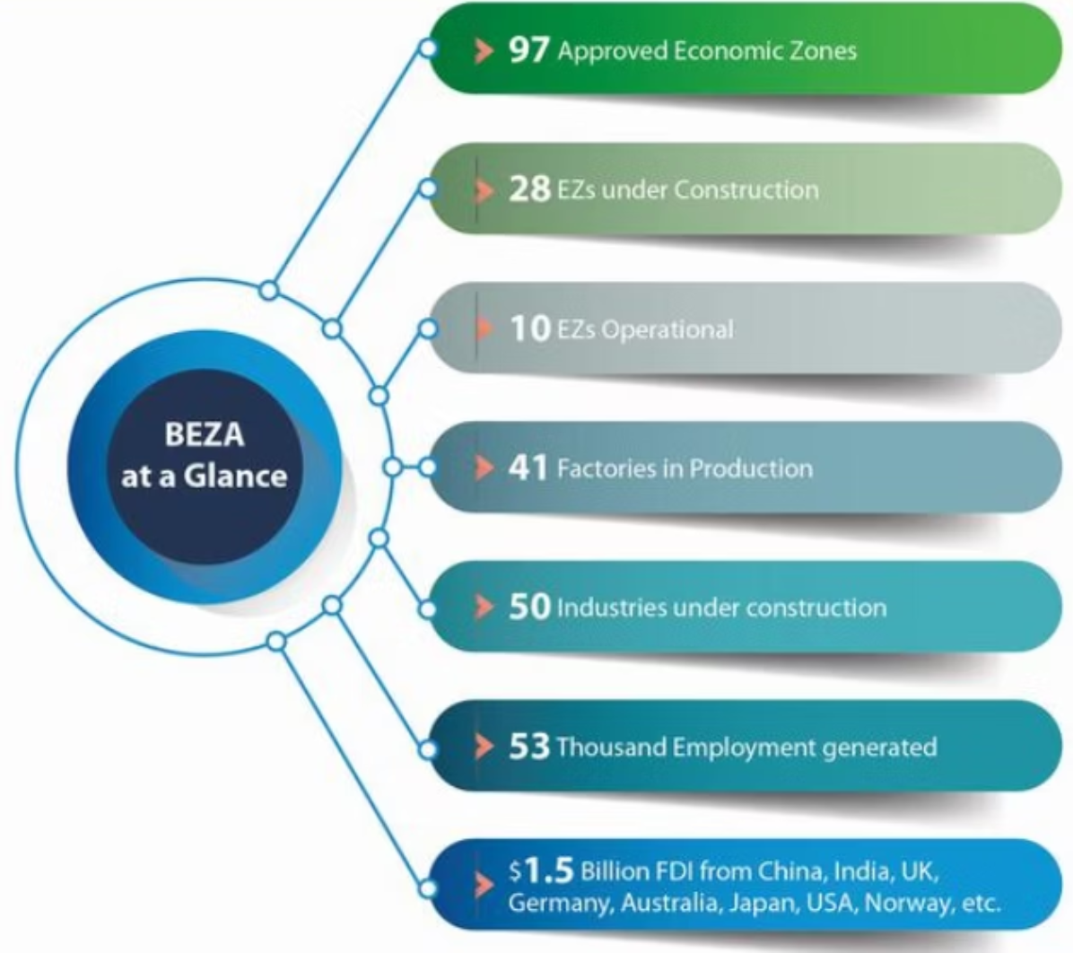
Economic Zones of Bangladesh
Source: BEZA Annual Report, 2022-23
100 Economic Zones planned
Country specific allocation
BSMSN is the Flagship Economic Zone
1 Special Zone for Japanese Investors
Special and additional incentives for investors

Slide 16
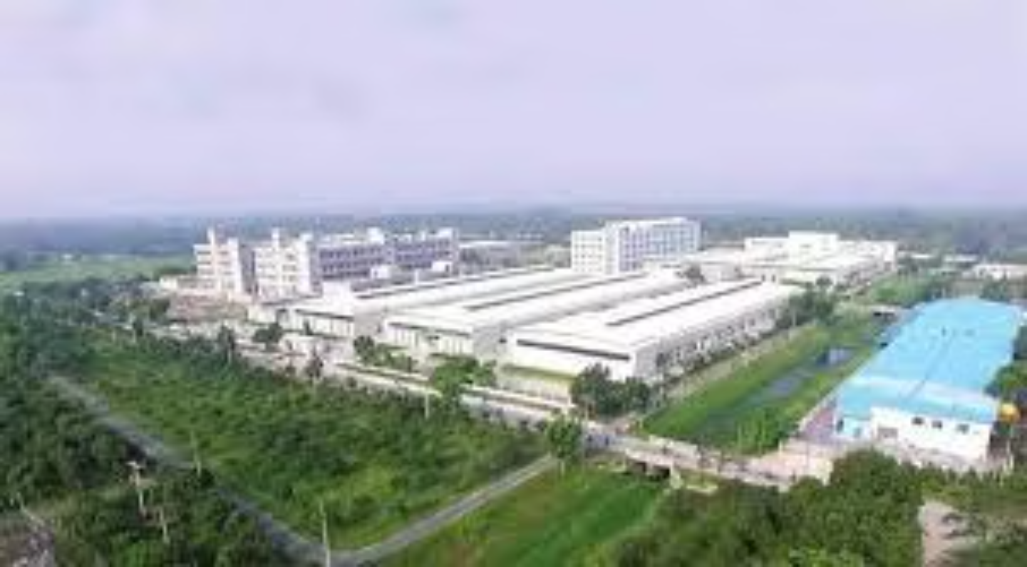
Export Processing Zones of Bangladesh
452 Companies in operation
104 Implementation
38 countries Already Invested in the EPZs of Bangladesh
Total Investment: $7.8 Bn
Total Export: $108.9 Bn
9 Zones: Established
1 USD investment has created 14 USD of Export
3 Zones: Upcoming

Slide 17
F. Tax benefits for Industries set up in Hi-Tech Park Zone:
The business income of industries set setup is exempted from Income tax for next 10 years from the date of commercial operation in the following manner:
Year
Exemption % of income
1st, 2nd and 3rd
100%
4th year
80%
5th year
70%
6th year
60%
7th year
50%
8th year
40%
9th year
30%
10th year
20%
Moreover, capital gains arising from transfer of share capital, royalty, technical Know-how and Technical assistance fee and declared dividend paid by such company are 50% exempted from Income tax for next 10 years from the date of commercial operation.
The foreign technicians appointed in investing unit will get 50% tax exemption for first 3 years.

Slide 18
G. Tax benefits for developers of Hi-Tech Park Zone:
The business income of developers of Hi-Tech Park Zone is exempted from Income tax for next 12 years from the date of commercial operation in the following manner:
Year
Exemption % of income
1st, to 10th year
100%
11th year
70%
12th year
30%
Declared dividend is exempted from income tax for next 10 years from the date of commercial operation.

Slide 19
I. Tax benefits for Export Processing Zones
At present the following exemptions are available for industries set up in EPZ:
Area
Year
Exemption % of income
Set up in Dhaka, Mymensingh and Chittagong divisions excluding Rangamati, Bandarbon and Khagrachari districts
1st and 2nd year
100%
3rd and 4th year
50%
5th year
25%
Set up in Rajshahi, Khulna, Sylhet and Barisal divisions and Rangamati, Bandarbon and Khagrachari districts
1st, 2nd and 3rd year
100%
4th, 5th and 6th year
50%
7th year
25%

Slide 20
J. Tax exemption for business of software development or Nationwide Telecommunication Transmission Network (NTTN) and information technology enabled services(ITES)
Income derived from the business of software development or Nationwide Telecommunication Transmission Network (NTTN) and information technology enabled services (ITES) is to be tax exempt up to 30 June 2024.
The following are identified as Information Technology Enabled Services (ITES) -
Software development
Software or application customization
Nationwide Telecommunication Transmission Network(NTTN)
Digital animation development
Website development
Web site services
Weblisting
IT process outsourcing
Web site hosting
Digital graphics design
Digital data entry and processing
Digital data analytics
Geographic Information Services (GIS)
IT support and software maintenance service
Software test lab services
Call center service
Overseas medical transcription
Search engine optimization services
Document conversion, imaging and digital archiving
Robotics process out sourcing
Cyber security services

Slide 21
Double Taxation Agreements (DTAs)
Protecting Investor Profits:
Bangladesh has signed Double Taxation Avoidance Agreements (DTAAs) with over 41 countries to ensure that investors are not taxed twice on the same income.
Example: DTAA with the UK provides tax relief for UK investors in Bangladesh.
Facilitating Cross-border Capital Movement:
DTAAs simplify the tax process for international investors, fostering a better flow of foreign capital.

Slide 22
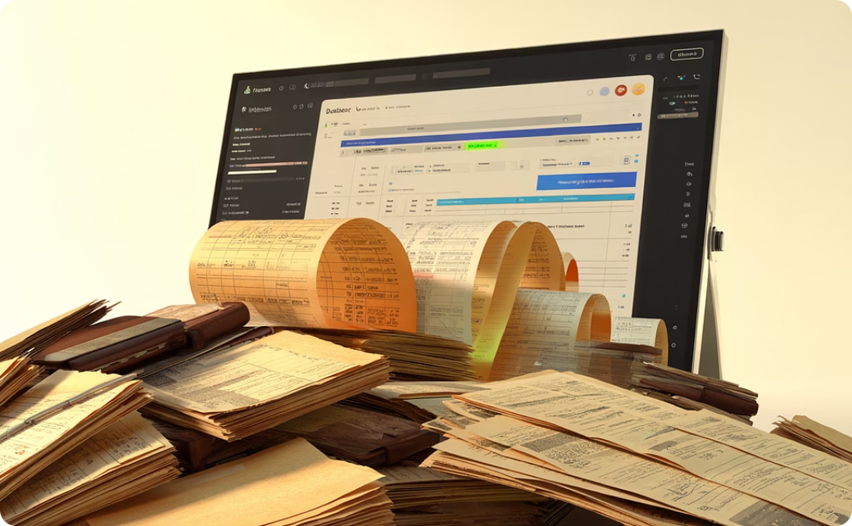


Tax Reform Journey: Building an Investment-Friendly Framework
Bangladesh has transformed its tax system to align with modern economic realities and international standards, creating a foundation for sustained investment growth.
System Modernization
International Alignment
Investor Incentives
Replaced the 40-year-old Income Tax Ordinance (1984) with the comprehensive Income Tax Act 2023 for a modern framework.
New tax legislation aligns with global economic standards and best practices, simplifying international compliance.
The 2025 Finance Ordinance introduced refined rates and streamlined compliance to enhance investor confidence and capital flow.

Slide 23


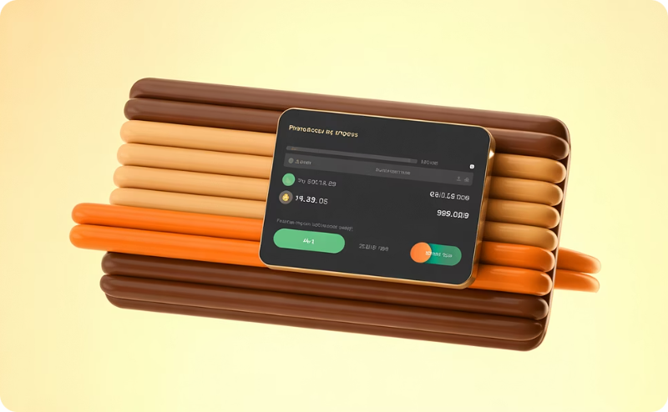
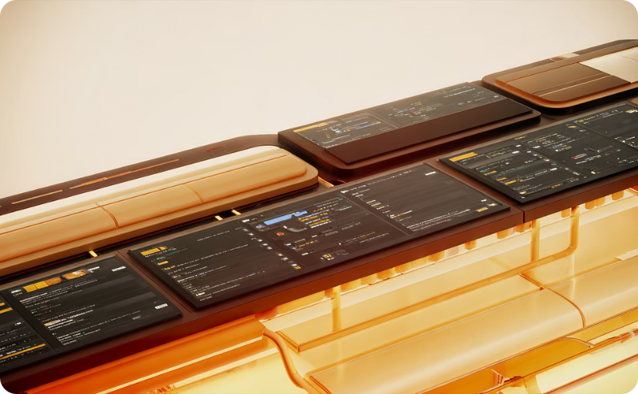
Digital Transformation in Tax Administration
NBR Electronic Services
E-filing System
Electronic Tax Payment
Efficiency & Automation
New e-service portals, including the e-filing system, allow investors to conveniently file taxes, access information, and resolve queries online.
NBR has introduced comprehensive electronic services to streamline tax filing, enhancing transparency and compliance ease for foreign investors.
Seamless electronic payment options are now available, simplifying tax transactions and improving overall efficiency for all taxpayers.
Automated tax assessments and processing significantly speed up procedures, leading to greater efficiency and faster resolution of tax matters.

Slide 24
Challenges and Opportunities in Tax Policy Development
Challenges:
Address global economic shifts, including changing international tax laws and rising competition from neighboring countries.
Difficulty in enforcing tax compliance in remote or informal sectors.
Opportunities:
Leveraging Technology: Use of AI and big data to enhance tax collection and compliance.
Further Tax Reforms: Continued focus on making the tax system simpler and more attractive for foreign investors.

Slide 25



Future Growth Areas
Bangladesh's dynamic economy is poised for significant expansion across several high-potential sectors, offering new opportunities for innovation and investment.
Digital Economy & IT
Pharmaceuticals
Agro-processing
Rapid adoption of digital technologies and a skilled young workforce are fueling exponential growth in software development, IT-enabled services, and e-commerce.
A robust domestic pharmaceutical industry is expanding globally, driven by competitive manufacturing, research capabilities, and access to international markets.
Transforming its strong agricultural base, Bangladesh is developing a thriving agro-processing sector, adding value to produce for both local and export consumption.

Slide 26
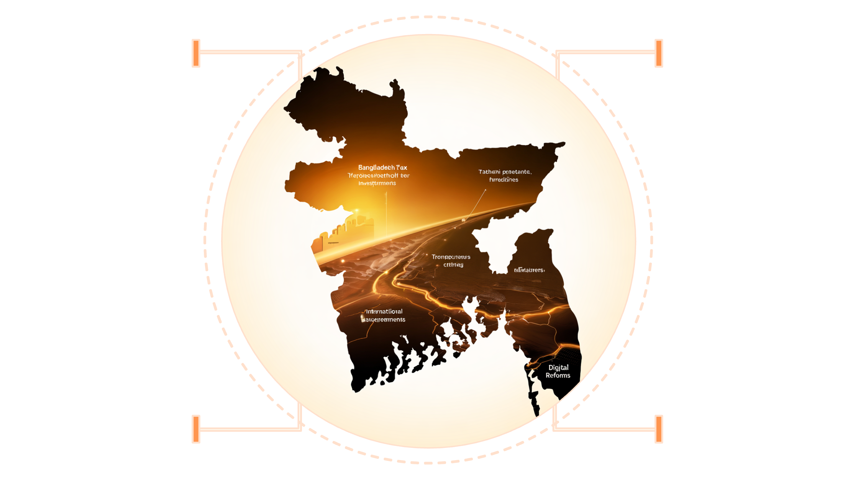
Final Thoughts:
Continued tax reforms, transparency, and digital transformation will further enhance Bangladesh’s position as an investment hub in South Asia.
Tax Incentives
Transparency
Preferential rates and exemptions
Clear rules and predictable policy
International Agreements
Treaties and investment protections
Digital Reform
Modern systems and compliance tech

