Slide 1


International Cooperation in Digital Taxation
A Framework for Bolstering Public Policy and Human Rights

Slide 2
Agenda
A Framework for Bolstering Public Policy and Human Rights
Core Thesis: From Cooperation to Citizenship
The Global Challenge: Why Unilateral Action Fails
The Catalyst for Change: The Role of International Organizations
Case Study: The DEC System and Cooperation in Practice
The Direct Connection: Digital Revenue and Support for Human Rights
Conclusion & Next Steps
Contact Information

Slide 3
The Cooperation Imperative
Isolated Actions Are Ineffective
  Individual efforts fail to address global tax challenges
  Leads to inefficiency and potential conflicts between nations
No Country Can Solve Alone
  Even the most powerful nations cannot tackle tax issues independently
  Global problems require collective solutions
International Cooperation Is Essential
  Collaboration is not optional but necessary
  Ensures fairness and modernization in the tax system
Path to a Fair Tax System
  Only through cooperation can a just system be achieved
  Modern tax frameworks depend on joint efforts

Slide 4
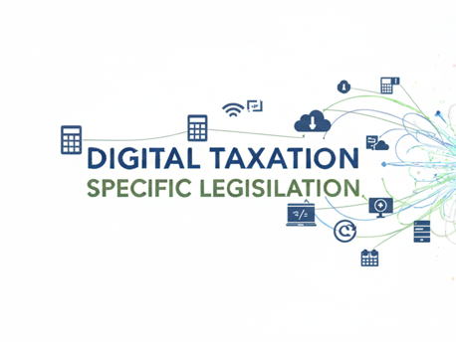
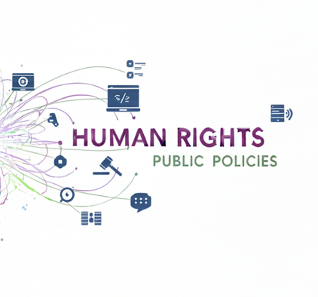
The Digital Paradox
The Digital Paradox in the Economy
  Digital economy creates value across borders
  Traditional tax systems remain confined by national boundaries
Challenges for Taxation
  Difficulty in capturing value generated internationally
  Need for updated frameworks to address digital realities
Importance of International Cooperation
  Collaboration between states is essential
  Enables collection of additional tax revenue
Strengthening Public Policies
  Increased revenue supports stronger public policies
Guaranteeing Citizens' Rights

Slide 5
Building Global and Regional Consensus
Global Organizations as Catalysts
  OECD plays a pivotal role in shaping international standards
  Facilitates cooperation among countries for tax policy
  Network Tax Organization - NTO
Regional Associations' Influence
  ATAIC, ATAF, CATA, CIAT, COTA, CREDAF, IOTA, PITAA, SGATAR, WATAF – NTO = 180 countries
  Promotes collaboration and shared best practices
Learning from Other Regions
  CIAT in the Americas offers a successful model, administration, capacitation, electronic invoice, digital compliance and other
  Demonstrates effective regional cooperation

Slide 6
The Concrete Problem: Taxing Digital Micro-Transactions
Challenge of Taxing Digital Services
  Foreign companies sell streaming, software, and advertising services
  Billions of micro-transactions occur globally
Complexity in Tax Collection
  Each transaction is small but collectively significant
  Traditional tax systems struggle with volume and scale
Need for International Cooperation
  Cross-border sales complicate enforcement
  Effective solutions require collaboration between countries
DEC System as a Case Study
  Examines practical approaches to digital tax management
  Focuses on real-world implementation and cooperation

Slide 7
  The Collaborative Solution: DEC (Digital Economy Compliance)
  The Concrete Problem: How can a country enforce its tax laws on foreign digital service providers that have no physical presence in its jurisdiction?
A comprehensive tax compliance portal specifically designed for non-resident taxpayers. Its goal is to provide a simple way for these companies to comply with the laws of each country and meet their tax obligations
Key Functions:
Simplified Taxpayer Registration: Provides a streamlined portal for foreign companies without a local physical presence to register as taxpayers.
Sales Declaration: Allows registered taxpayers to periodically declare their sales within the jurisdiction.
Automated Tax Calculation: The system calculates the tax owed based on the declared sales and pre-set local parameters.
Tax Control & Collection: Manages the tax collection process, tracking liabilities and payments through a dedicated current account system

Slide 8
DEC System - Digital Economy Compliance System
Driving Compliance: The Carrot and the Stick
The "Carrot": Facilitating Voluntary Compliance
  Most large multinational companies want to comply with local laws to ensure legal certainty and maintain good corporate governance. They often priorities this.
  A simplified system like DEC is the "carrot": It provides a straightforward, low-cost, and clear path for well-intentioned companies to meet their tax obligations spontaneously.
The "Stick": Persuasion and Enforcement Mechanisms
  For entities that choose not to comply, the framework must include effective enforcement tools. These mechanisms persuade compliance by creating clear financial consequences:
  Tax Withholding at Source: Mandating that financial intermediaries (such as banks and credit card processors) automatically withhold the applicable tax from payments made to non-compliant companies
  Blocking Digital Services: As a final resort, electronically blocking all access to the non-compliant company's digital products and services within the jurisdiction
  Visual representation clarifies process

Slide 9
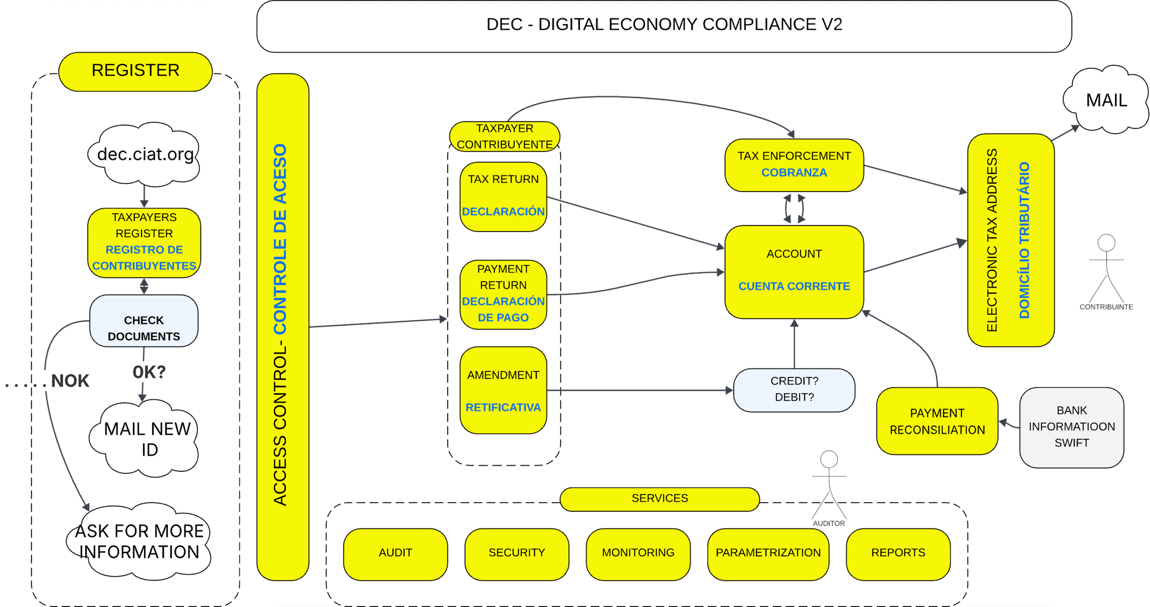

Slide 10
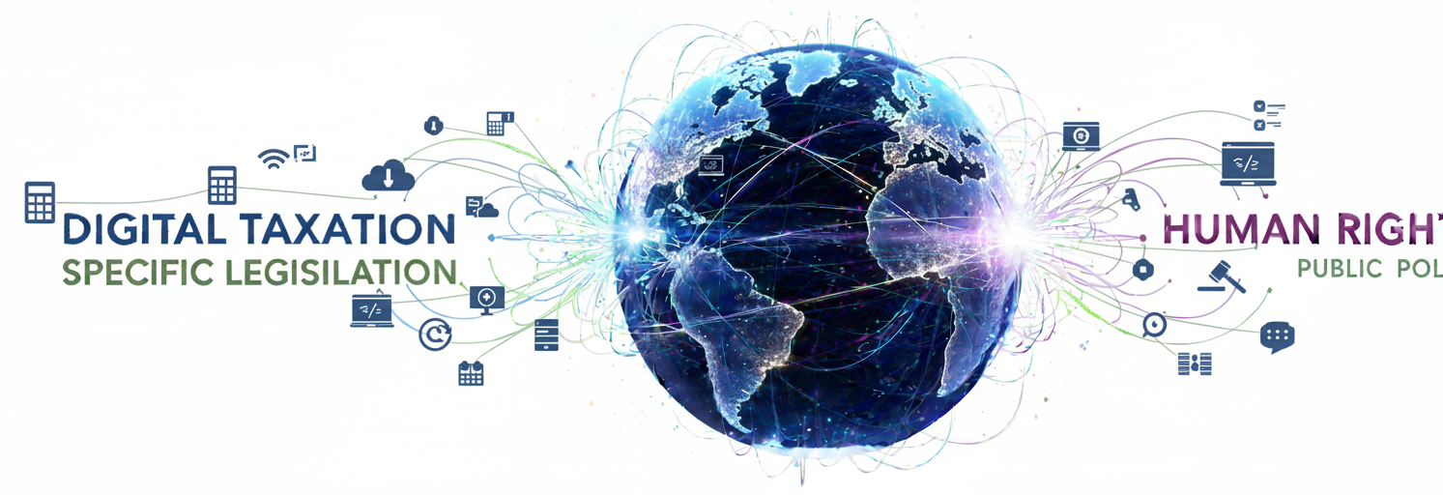

Slide 11
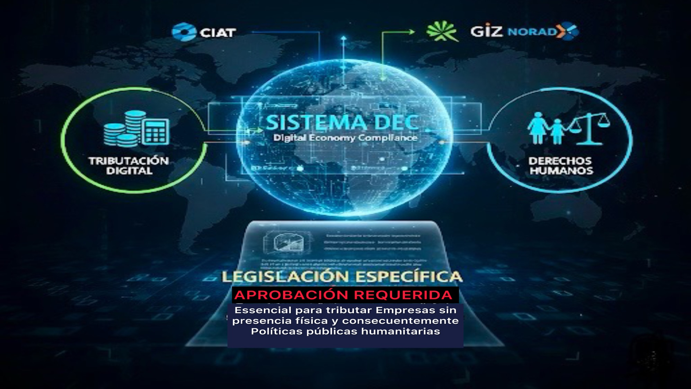

Slide 12
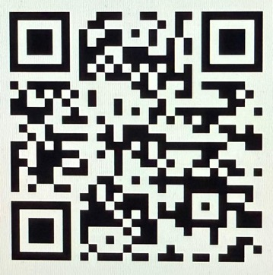
Join Us for the 60th CIAT General Assembly
Where: Punta Cana, Dominican Republic
When: 12-14 May 2026
* 15 May 2026, Technology international Journey
We warmly encourage you to stay one extra day for our traditional Technology Seminar.
A formal 'Save the Date' will be sent out shortly.
We look forward to seeing you there.
Thank You!
Decio Carretta
CIAT’s Brazil Representation
dcarretta@ciat.org
+5563992769119 (Whatsapp)
www.ciat.org
Notes:
Join us for the
60th CIAT General Assembly in Punta Cana, Dominican Republic, from 12-14 May 2026.
Technology Seminar on 15 May.
'Save the Date' will be sent out shortly

