Slide 1

Tax Incentives Principles (TIPS)
Christophe Waerzeggers (IMF)
November 2025

Slide 2
Introduction
PCT
Tax Incentives Principles (TIPS)
  Overview
  Consultation process
  Preview of e-learning tool
TIPS as a framework for TE evaluation
Conclusion

Slide 3










Platform for Collaboration on Tax (PCT)
The PCT is a joint initiative to enhance collaboration on Domestic Resource Mobilization (DRM).
PCT brings together experiences & expertise of the four leading multilateral organizations active in tax matters.
Collaboration for developing guidance and tools that assist countries with tax system reforms.
Key areas of work include Environmental Taxation, Medium-Term Revenue Strategy (MTRS) and International Taxation (with a specific focus on tax incentives)
Funding from France, Japan, the Netherlands, Norway, Switzerland and the UK.
www.tax-platform.org

Slide 4
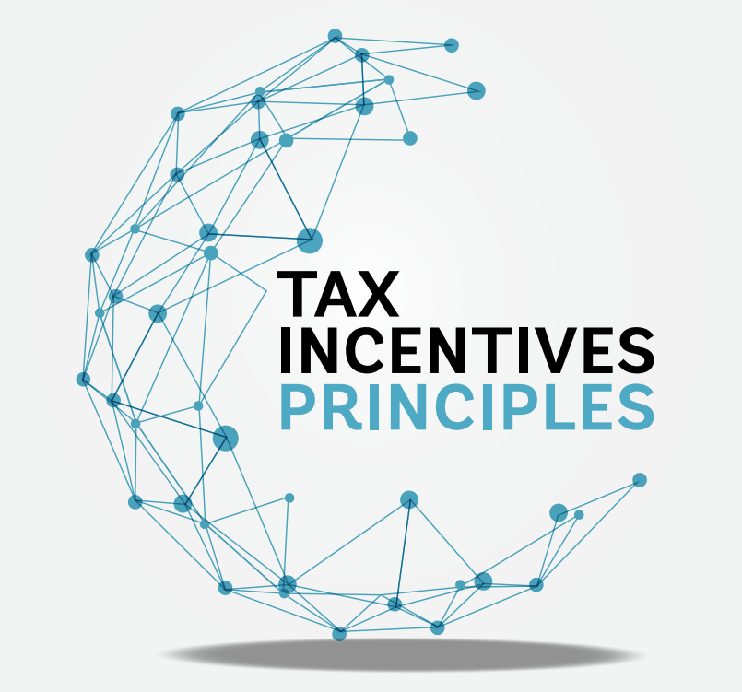

Tax Incentives Principles
Tax Incentives Principles—along ith detailed accompanying remarks—were published online in May 2025. https://www.tax-platform.org/tax-incentives
  The Tax Incentives Principles build on the 2015 PCT G20 report: Options for Low Income Countries’ Effective and Efficient Use of Tax Incentives for Investment (Main Report and Background Paper)
Published alongside a Compilation of Comments Submitted following a public consultation process
E-Learning on Tax Incentives Principles to follow

Slide 5

Tax Incentives Principles (TIPS)
The TIPS are intended to help policymakers identify and secure any potential social gains from tax incentives while avoiding potential pitfalls.
They are aspirational.
  Few countries fully comply with all.
  Many countries face capacity constraints, which may make meeting even some of the most basic of the TIPS challenging. This highlights the importance of carefully assessing the design and implementation of incentives in light of available capacity.
  But for all countries, they present a clear view of what should be aimed for and can provide a basis for progress or reform.
There are six broad principles, each with sub-principles, spanning the “life cycle” of a tax incentive:
Justification
Evaluation
Design
Tax Incentives
Principles
Implementation
International Considerations
Legislation

Slide 6
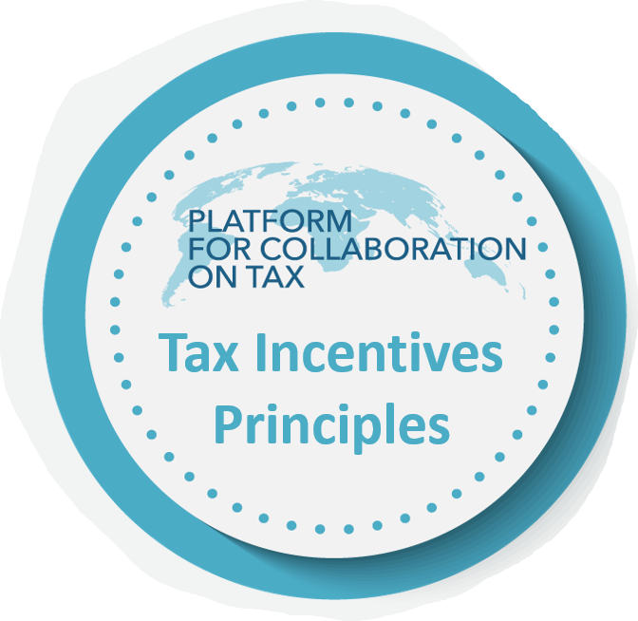
Principle 1: Justification
P1. An incentive may be justified only if net social benefits can reasonably be expected, for reasons that are publicly articulated
P1.1. An incentive can be justified only if the activities it is intended to promote generate benefits to society beyond the private gain that recipients will enjoy
P1.2. The likely social costs of any incentive, including—but not only—its implications for tax revenue, should be identified
P1.3. An incentive may be justified if there is good reason to expect its social benefits to exceed its social costs—with an ex-ante assessment, ideally quantified, made public
P1.4. Tax incentives should not be used if more appropriate policy instruments serving the same policy objectives are available
Justification
Evaluation
Design
Tax Incentives
Principles
Implementation
International Considerations
Legislation

Slide 7
Principle 2: Design
P2. Incentives should be designed to promote the favored activity while avoiding unnecessary distortions to other activities and limiting the revenue cost
P2.1. Incentives should be targeted on the expected source of social benefit, while avoiding excessive complexity
P2.2. In the investment context, targeting considerations will often point to the use of cost-, rather than profit-based incentives
P2.3. Unwelcome side effects should be anticipated and guarded against
P2.4. Exposure to revenue loss should be limited, including by using sunset provisions
Justification
Evaluation
Design
Tax Incentives
Principles
Implementation
International Considerations
Legislation

Slide 8
Principle 3: International Considerations
P3. Incentive design should be sensitive to international commitments and circumstances, and with an openness to mutually beneficial cooperation
P3.1. Incentives should be consistent with international commitments
P3.2. Incentive design should take account of tax rules and strategic responses elsewhere
P3.3. Through international cooperation, opportunities should be sought to limit the risks and mutual damage that incentives can create
P3.4. Even looking beyond their self-interest, countries may wish to take account of the impact of their incentive policies on others
Justification
Evaluation
Design
Tax Incentives
Principles
Implementation
International Considerations
Legislation

Slide 9
Principle 4: Legislation
P4. Incentive legislation should be clear, integrated into tax law and subject to effective oversight
P4.1. Tax incentive policies should not be enacted without review, and an expression of opinion, by the ministry of finance
P4.2. Incentive legislation should be clear, minimize discretion, and have robust governance safeguards
P4.3. Incentives should be ratified by the law-making body or parliament
P4.4. All incentives should be consolidated in the main body of tax law, and publicized
Justification
Evaluation
Design
Tax Incentives
Principles
Implementation
International Considerations
Legislation

Slide 10
Principle 5: Implementation
P5. Tax incentives should be implemented so as to promote voluntary compliance, mitigate revenue and governance risks, and provide the data needed to evaluate them
P5.1. The administration of incentives should be under the control of the revenue administration, appropriately empowered
P5.2. Basic compliance obligations should not be
waived
P5.3. Voluntary compliance should be supported by tailored service, assurance, and enforcement strategies
P5.4. Rules and institutional arrangements should be in place to assure the inter-agency cooperation, and provide the data, needed for implementation, monitoring and assessment
Justification
Evaluation
Design
Tax Incentives
Principles
International Considerations
Implementation
Legislation

Slide 11
Principle 6: Evaluation
P6. All tax incentives should be subject to periodic, public, and evidence-based ex-post evaluation
P6.1 Tax expenditures associated with all incentives should be estimated and published regularly
P6.2 Tax expenditure reports should include broad information on the beneficiaries
P6.3 Incentive legislation should include a program for periodic, credible, and public evaluation
P6.4 Evaluations should pay attention to the behavioral and external effects of incentives, and be undertaken with an intensity proportional to their likely significance
Justification
Evaluation
Design
Tax Incentives
Principles
Implementation
International Considerations
Legislation

Slide 12
TIPS as a framework for TE evaluation
Tax Expenditure Evaluation can take many forms
  Cost-benefit analysis
  Impact Assessment
  Distributional analysis
TIPS aren’t envisaged to provide specific methodologies for assessing the effectiveness, efficiency, equity, or costs of a given tax incentive.
But they can be utilized as a framework to support evaluation of the justification, design, international considerations, legislative elements, implementation and evaluation frameworks.
For example: Implementation (P5.4)
Are institutional arrangements in place to assure inter-agency cooperation, [collect and] provide the data, needed for implementation, monitoring and assessment?
If not – what are the bottlenecks, what steps need to be taken to solve them? E.g., change in design of tax return form; data-sharing agreement/legislation between agencies; designation of roles and responsibilities for monitoring and assessment.

Slide 13
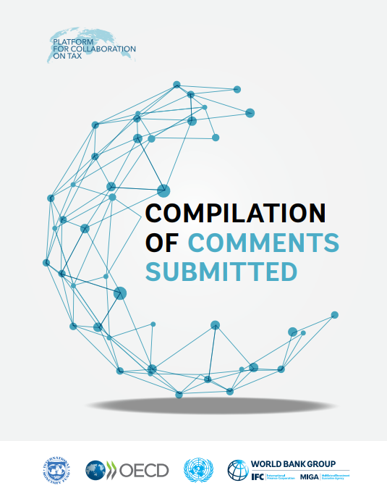
TIPS Consultative Process
TIPS Public consultation occurred late 2024-early 2025
Invited comments & submissions on a draft of the principles, related to:
  Appropriateness
  Balance
  Level of guidance
  Support required to implement
  Other recommendations
>35 submissions received from governments, think tanks, private sector organizations, researchers and individuals.
  Available online
Very helpful process – e.g., highlighted where more emphasis or consistency was required; incorporated a broad range of viewpoints from many jurisdictions; highlighted gaps and where there was demand for further work.

Slide 14
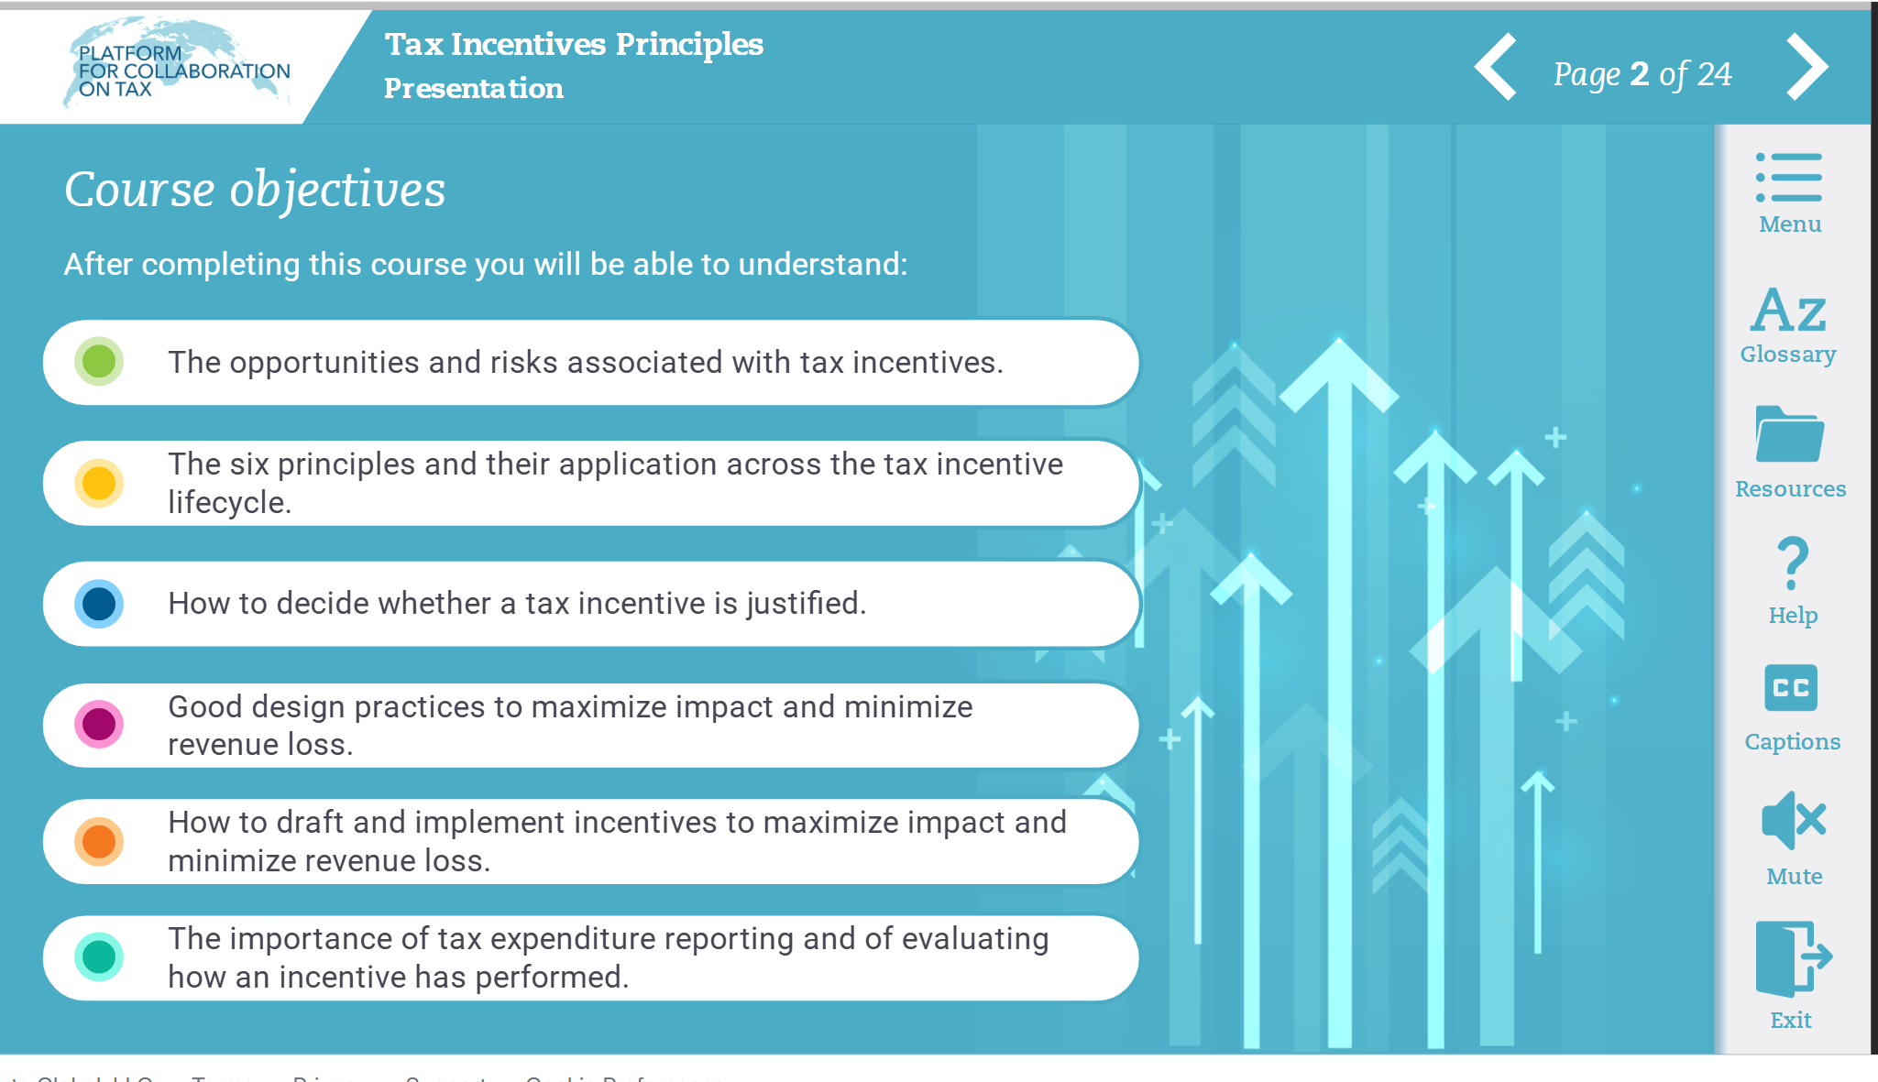
E-learning tool
Interactive module for exploring the Tax Incentives Principles
Provide a summary of each of the Principles
Detailed Glossary & links to Resources (further reading, guides, datasets, from the PCT Partners and external sources), tagged according to each principle
Interactive videos and quiz to test learning
Coming soon!
PREVIEW

Slide 15



Thank you!
www.tax-platform.org/contact
taxcollaborationplatform@worldbank.org

